Slide 1
Earth’s Movements
The study of forces affecting the crust of the earth or geological processes is of paramount significance because these forces and resultant movements are involved in the creation, destruction, recreation and maintenance of geomaterials and numerous types of relief features of varying magnitudes.
These forces very often affect and change the earth’s surface. In fact, the change is law of nature.
The geological changes are generally of two types:-
1). Long period changes,
2). Short period changes
The forces, which affect the crust of the earth are divided into two broad categories on the basis of their sources of origin.

Slide 2
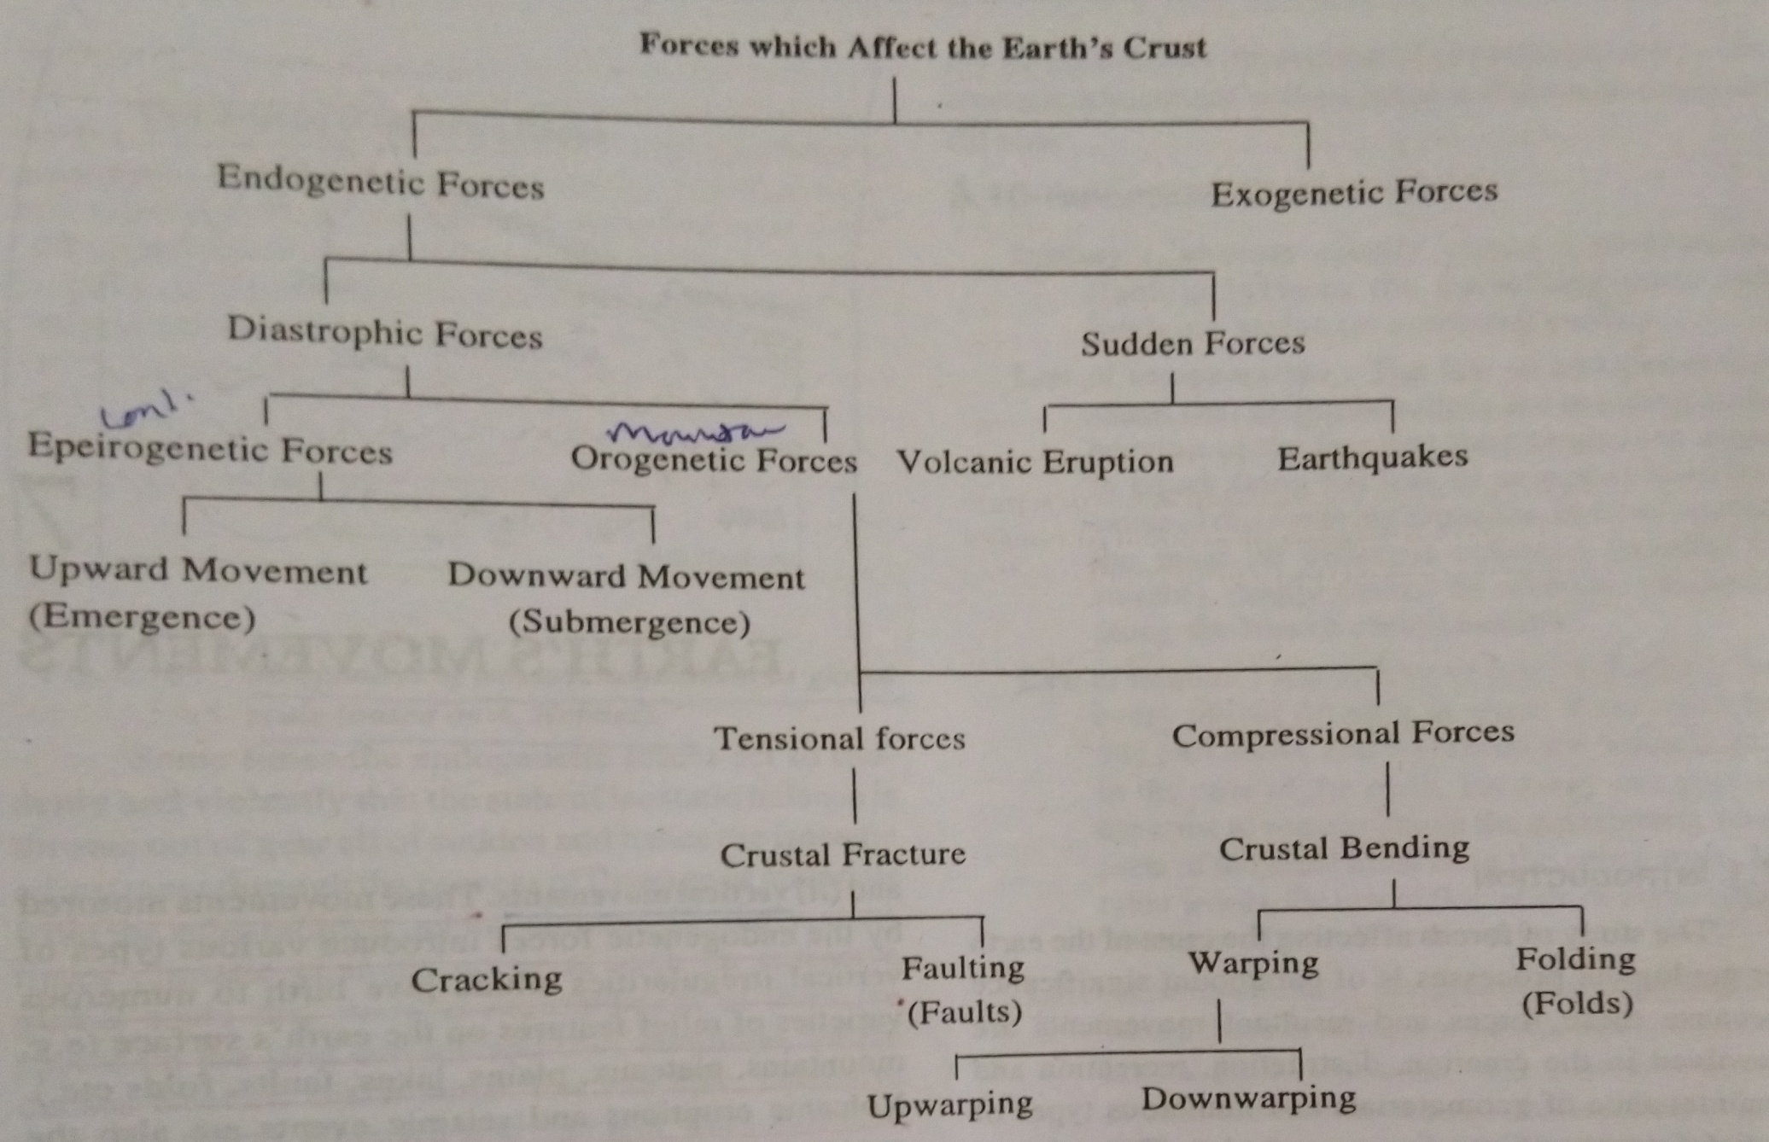
FORCES

Slide 3
Endogenetic Forces
The forces coming from within the earth are as endogenetic forces which cause two types of movements in the earth (1). Horizontal movements (2). Vertical movements.
These movements motored by the endogenetic forces introduce various types of vertical irregularities which give birth to numerous varieties of relief features on the earth’s surface (mountains, plateau, plains, lakes, faults, folds etc.).
Volcanic eruption and seismic events are also the expressions of endogenetic forces. Such movements are called sudden movements.
The enogenetic forces and movements are divided on the basis of intensity, into two major categories.

Slide 4
Sudden forces and movement
Sudden movement, caused by sudden endogenetic forces coming from deep within the earth, cause such sudden and rapid events that cause massive destruction at and below the earth’s surface.
Such events, like volcanic eruption and earthquake, are called ‘extreme events’ and become disastrous when they occur in densely populated areas.
These forces work very quickly and their results are seen within minutes. It is important to note that these forces are the result of long period preparation deep within the earth.
Geologically, these sudden forces are termed as ‘constructive forces’ because these creates certain relief features on the earth’s surface.

Slide 5
Diastrophic forces and movements
Diastrophic forces include both vertical and horizontal movements which are caused due to forces deep within the earth.
These diastrophic forces operate very slowly and their effects become discernible after thousands and millions of years.
These diastrophic forces and movements are further subdivided into two groups:
(1). Epeirogenetic movements.
(2). Orogenetic movements

Slide 6
Epeirogenetic movements
The eperiogentic word consists of two words, ‘epiros’ (meaning thereby continent) and ‘Genesis’ (meaning thereby origin).
Epeirogenetic movements cause upliftment and subsidence of continental masses through upward and downward movements respectively. Both the movements are, in fact, vertical movements.
These forces affect larger parts of the continents.
These forces are further divided in to two types:
1). Upward movements.
2). Downward movements.
Upward movement causes upliftment of continental masses in two ways: 1). Uplift of whole continent,
2). Upliftment of coastal land.
Such movements also called Emergence.

Slide 7
Downward movement
Downward movement cause subsidence of continental masses in two ways:
1). Subsidence of land area,
2. The land area near the sea coast is moved downward or is subsided below the sea level.
Such type of downward movements is called as submergence.

Slide 8
Orogenetic movement
The word orogenetic has been derived from two Greek words, ‘Oros’ (meaning there by mountain) and ‘Genesis’ (meaning thereby origin).
Orogenetic movement is caused due to endogenetic forces working in horizontal (tangential forces) manner.
Orogenetic or horizontal forces work in two ways:
1). In opposite directions,
2). Towards each other,
This is called tensional force when it operates in opposite directions. Such types of force and movement are also called as divergent force.
Thus, tensional forces create rupture, cracks, fracture and faults in the crustal parts of the earth.
The force, when operates face to face, is called compressional force or convergent force.
Compressional force causes crustal bending leading to the formation of folds.

Slide 9
Folds
Wave-like bends are formed in the crustal rocks due to tangential compressive force resulting from horizontal movement caused by the endogenetic force originating deep within the earth. Such bends are called folds wherein some parts are bent up and some parts are bent down.
The upfolded rock strata in arch like form are called anticlines while the down folded structure forming trough-like feature is called syncline.
The two sides of a fold are called limbs of the fold.
The limb which is shared between an anticline and its companion syncline is called middle limb.
The plane which bisects the angle between two limbs of the anticline or middle limb of the syncline is called the axis of fold or axial plane

Slide 10
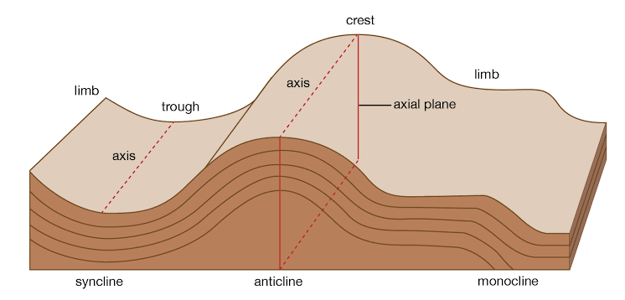
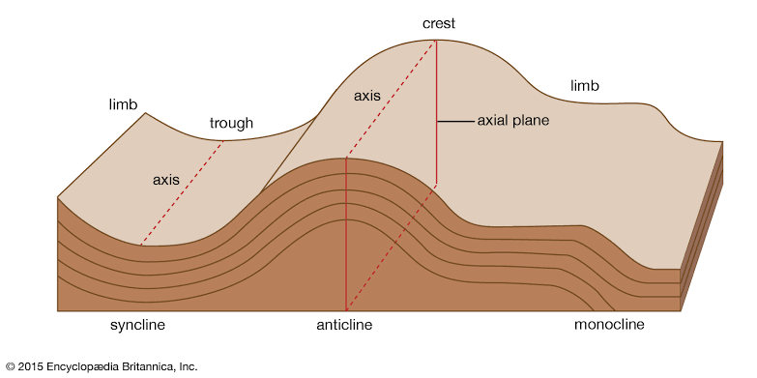
Diagrammatic presentation of Folds

Slide 11
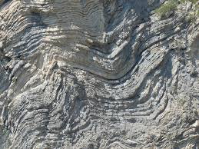
folds

Slide 12
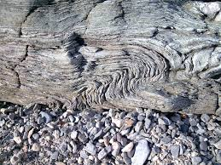

Slide 13
Dip and Strike
Dip and strike as it becomes absolutely necessary to understand them in order to understand the structural form.
The inclination of rock beds with respect to horizontal plane is termed as ‘dip’.
It is apparent that we derive two information about the dip:
1). The direction of maximum slope down a bedding plane.
2). The angle between the maximum slope and the horizontal plane.
The angle of dip is measured with an instrument called clinometers.
The strike of an inclined bed is the direction of any horizontal line along a bedding plane. The direction of dip is always at right angle to the strike.

Slide 14
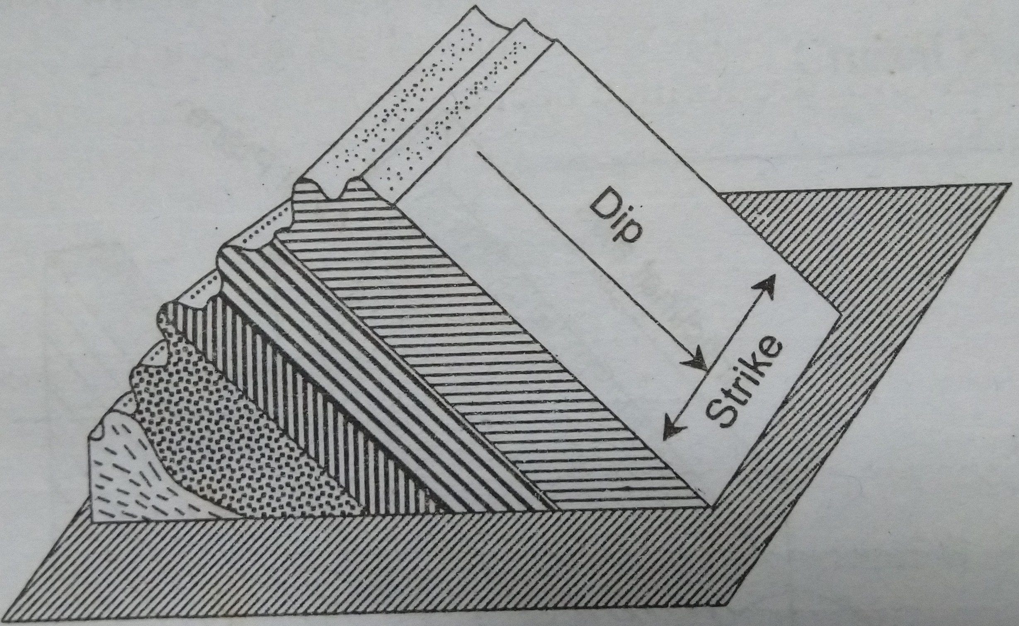
Dip and Strike

Slide 15
Types of folds
Types
(1). Symmetrical folds
(2). Asymmetrical folds
(3).Monoclinal Folds
(4). Isoclinal folds
(5). Recumbent folds
(6).Overturned folds
(7). Fan folds
(8). Open folds
(9). Closed folds

Slide 16
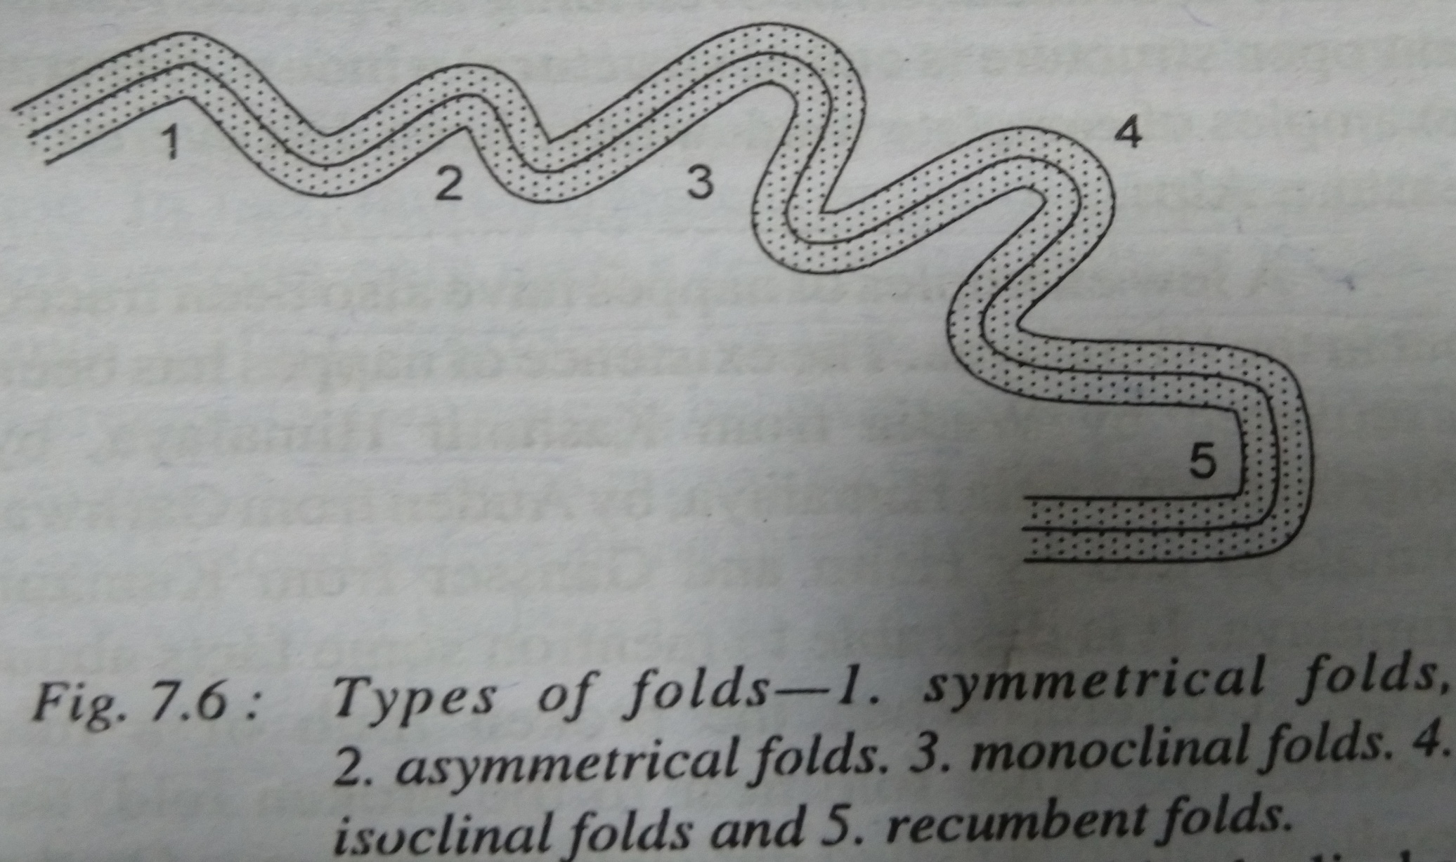
Types of folds Diagrammatic view

Slide 17
The nature of folds depends on several factors like, the nature of rocks, the nature and intensity of compressive forces, duration of the operation of compressive forces etc.
The elasticity of rocks largely affects the nature and the magnitude of folding process.
The softer and more elastic rocks are subjected to intense folding while rigid and less elastic rocks are only moderately folded.

Slide 18
Fold
Symmetrical Fold are simple folds, the limbs of which incline uniformily.

